Slide 1

Replicating Statistical Analysis Group 4: Raphael Kirchgäßner, Brian Karlberg, Meenakshi Mishra
Verbal monitoring in Parkinson’s disease: A comparison between internal and external monitoring Hanna S. Gauvin, Jolien Mertens, Peter Marien, Patrick Santens, Barbara A. Pickut, Robert J. Hartsuiker
Notes:
Verbal monitoring external vs internal

Slide 2
Summary of the paper we replicated
Simple research questions
Is verbal monitoring impaired in patients with Parkinson’s disease (PD)
Can internal tasks on speech perception predict internal monitoring performance?
Definition of key constructs
Internal vs. external monitoring
Pre/post articulation monitoring routes
Internal mechanism theories: perception or production based
Insights from other neurological disorders (Alzheimer’s, stroke, etc.)
Semantic and phonological impairments, syntactic complexity, etc.
Notes:
[post final point]
Grammatical errors
Intonation (prosody)
Rate of speech

Slide 3
Brief overview of measurement methods
Key method: noise masking condition to block external monitoring
Route to investigate functionality of internal monitoring
Unified Parkinson’s Disease Rating Scale: n=18, control group: n=16
Control variables, cognitive task variables, language variables
11 language tasks grouped into 4 categories:
Speech production
Internal speech perception
External speech perception
Verbal monitoring
Notes:
Noise masking to block external monitoring was key method
PD group 21 patients were native Dutch speaking with 21 age matched controls
3 main categories of variables
*Goals:
Correlations on control variables with speech production
Correlations on speech productions variables with disease status
Regression to predict monitoring performance based on measures of production and perception

Slide 4




Methods (continued)
Questionnaire, Edinburgh Handedness
Cognitive performance tests
Mini mental state examination (MMSE)
Raven Matrices
Boston Naming Test (BNT)
Controlled oral word association test (COWAT)
Software and hardware:
E-Prime and PowerPoint running on laptop
Cedrus RB-x30 response box
Sennheiser HD 250 over-ear headphones
Roland R-1 mp3 recorder
SPSS 22, t-tests, ANOVA, regression
Mann-Whitney, Wilcoxon Signed-rank
Notes:
2 control vars were
Questionnaire
Language pathology history
Audio and visual deficits
Perception of PD onset
2 cognitive tasks
Mini mental state evaluation – global cognitive performance
Raven progressive matrices test for non verbal intelligence
2 Speech production tasks
BNT for picture naming
COWAT for phonological and semantic fluency
In addition to several other speech monitoring tasks:
Palpa tests, homophone and phoneme tasks, visual and auditory rhyming, network production and perception
Software/hardware
Alpha .05

Slide 5
Summary of Findings
Meta-result: PD patients do not differ in verbal monitoring performance rather they differ in how they achieve verbal monitoring.
Correlation results:
Age and Hoehn & Yahr (r = .646, p = .009)
COWAT, BNT no difference
Rhyme – condition only, Phoneme – group and condition
Auditory rhyme task – group, condition, and interaction effects
Group control disfluencies interaction effect (p = .045)
Regression: differences in division of labor between internal and external monitoring
Notes:
Semantic and phonological monitoring were primary tests: meta result
Control variable results
Positive correlation between age and Hoehn Yahr (r = .646, p=.009)
Age and MMSE (r = .544, p = .020)
Hoehn and Yahr and MMSE (r=.54 , p=.044)
Length of Parkinson's and deep brain STN stimulation (r = .617, p=.008) [subthalamic nucleus]
Negative correlation between age and MMSE (r = -.343, p=.047)
Speech production
COWAT: no significant difference between PD and control group for semantic for phonological fluency
BNT: no difference [table 3]
Internal speech perception
Visual rhyme judgment task – no effect of group, significant effect of condition
Homophone decision task - no effect of group or condition
Phoneme monitoring task - significant main effect of group and condition
External speech perception
Auditory rhyme – group and condition effects observed as well as an interaction effect
Network perception task – no observed effect
Verbal monitoring variables
No significant effect for errors repaired or produced
Significant group/control interaction of disfluencies (p = .045)
Discrepancy in definition of disfluencies between this and other studies
PD made more disfluencies under noise
Regression
Verbal monitoring variable as independent variables
Speech production task as independent variables
Also multiple regression was done

Slide 6
Issues identified in data quality review
Raw table data apparently labeling fractions as percentages
Understanding what the data variables represented – examples:
Levodopa
Hoehn Yahr Scale
MMSE
Gender variable coded as one or zero, m and v elsewhere
Potential for geographic bias
Small sample size < 30
Notes:
Levodopa is an

Slide 7
EDA highlights, focusing on why each plot/data summary table was done, and what was learned

Slide 8
EDA highlights, focusing on why each plot/data summary table was done, and what was learned

Slide 9
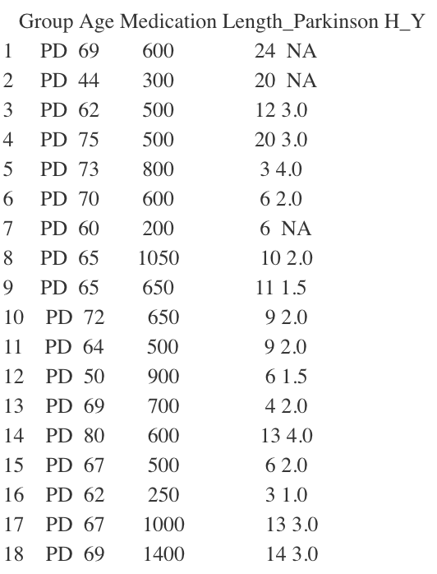
Description of Replication - Table 1
Using the tidies dataset
Filter for group == PD
Selected 5 columns
Print Table1
Notes:
"Group","Age", "Medication", "Length_Parkinson","H_Y"

Slide 10
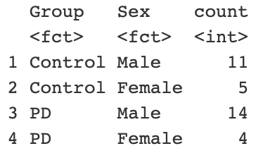
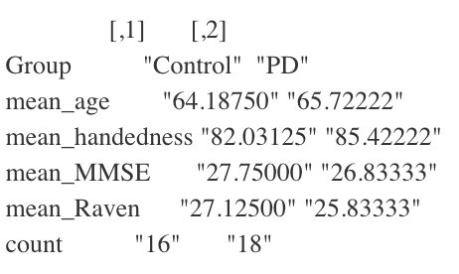
Description of Replication - Table 3
Used the tidied dataset
Selected 6 columns
Grouped by “Group”
Used a separate table to show the amount of males and females in each group
Notes:
"Age", "Sex", "Handedness","MMSE","RAVEN","Group"

Slide 11
Description of Replication - Table 9
Using tidied dataset
Selected seven columns using select
Used gather to collect columns into a dictionary with the Error_type as key and the according value is named total_number
Filled pause was key indicator of shift to internal monitoring
Notes:
We selected seven columns: Group”,“Nrm_Reformulation”,“Nrm_FilledPause”,“Nrm_Repetition”,“Nois_Reformulation”,“Nois_FilledPause”, “Nois_Repetition”

Slide 12
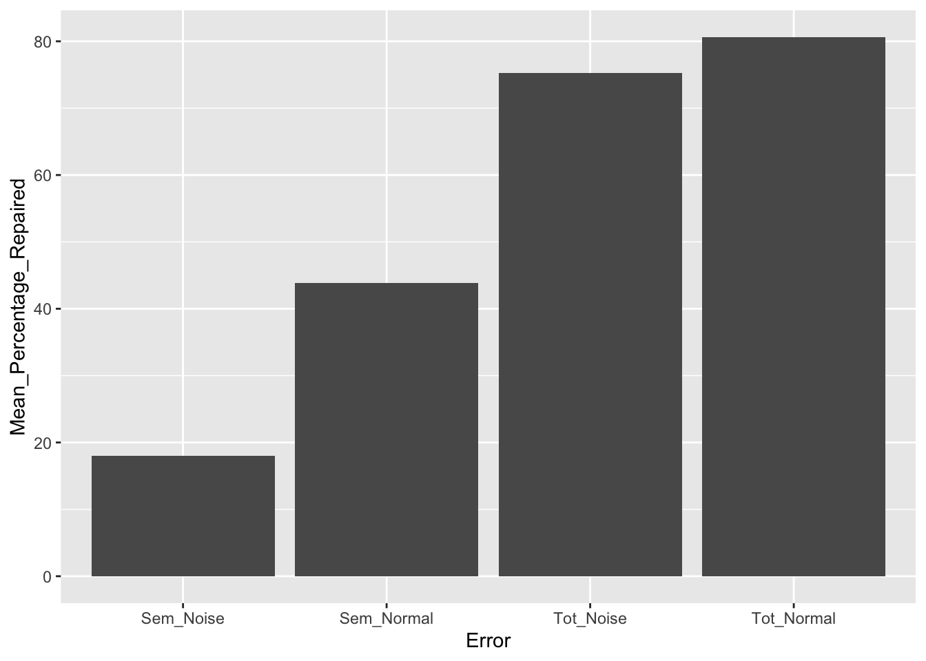
Description of Replication - Figure 1
Tidied dataset
Gathered 5 values via the key “Error”
Shows difference in semantic error with total error for the control group

Slide 13
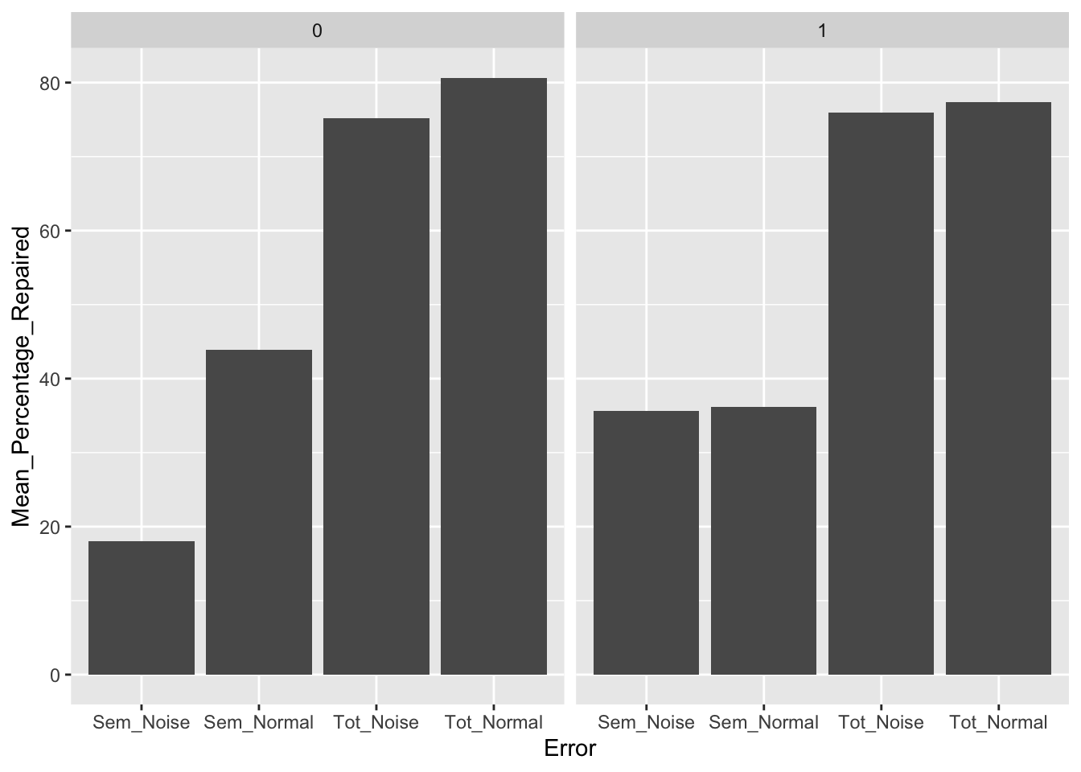
Description of Replication - Figure 2
Tidied dataset
Gathered 5 values via the key “Error”
Facet by group
Left hand side shows Parkinson’s disfluencies under normal and noise
Right hand side shows control disfluencies under normal and noise

Slide 14
Three biggest takeaways from doing this project
Experimental methods can leverage statistics to understand cognitive processes using language assessment
Variable datatypes can be challenging to decipher without clear documentation
The combination of input data and method of analysis can result in drastically different conclusions
Notes:
Literature review and comparisons embedded throughout paper
What does the column header mean? – codebook. Issues later too with binary gender code and percent vs decimal
Two levels
how we had to interpret data to achieve reproducibility
How the researches cited and themselves achieved different results from previous published data

Slide 15
Thanks & Questions

